Slide 1
bitbangers CPU
Devul, Sanjana, Aditya
. . . . . . . . . . . . . . . . . . . .
. . . . . . . . . . . . . . . . . . . .

Slide 2
Overview of Design
RV32IMA_Zicsr_Zifencei (with some sv32 support).
5-stage pipelined in-order, static not-taken branch prediction, etc., etc.
CLINT (interrupt controller compatible w/privileged spec)
Behavioral UART for co-simulation.
. . . . . . . . . . . . . . .
. . . . . . . . . . . . . . . .
. . . . .
. . . .

Slide 3
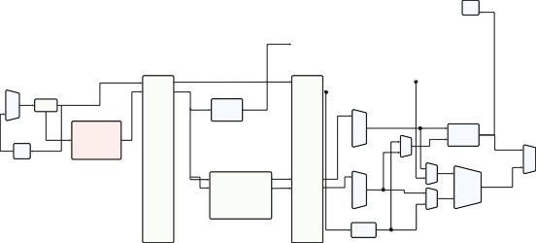
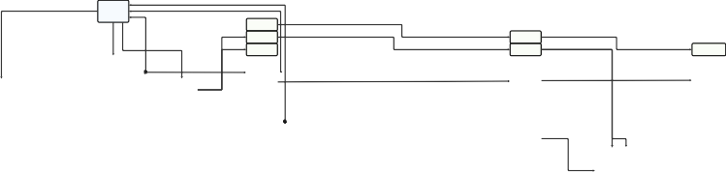
Datapath
br_en
Hazard Detection Unit
WB
MEM
WB
EX
MEM
WB
pc mux
PC
control_rom
Instruction Cache
fwd_a
CMP
MBE
+4
IF/ID
ID/EX
EX/MEM
MEM/WB
+4
LW
LB
LBU
rs1_idx
fwd_b
ALU
rs2_idx
regﬁle
Data Cache
LH
LHU
immgen
fwd_ctrl
. . . . . . . . . . . . . . .
. . . . . . . . . . . . . . . .
. . . . .
. . . .

Slide 4
More on features
Atomics: LR/SC are implemented without reservation stations since it’s a uniprocessor.
AMOs (read-modify-write) are implemented by trapping and emulating using LR/SC.
Zicsr — diﬀicult extension to do correctly since lots of edge cases. Chose to stall for four cycles to ensure no hazards, since enforcing privileged spec’s read/write permission constraints plus hazards was very expensive in area and did not improve performance since CSR instructions are rare.
Zifenci — implementing simple write-update snooping-based cache coherence between I$ and D$ to prevent flushes of D$. (Bus contention is not a concern since I$ is never written to.) This way, D$ never has to write back every cacheline on fence.i, the instruction and data streams are always in sync via snooping.
. . . . . . . . . . . . . . . . . . . .
. . . . . . . . . . . . . . . . . . . .

Slide 5
Why is nommu Nontrivial?
Requires building Linux in a certain way:
uClibc instead of glibc, make sure the busybox initramfs is OK w/this.
Create a flat binary instead of ELF so that we don’t need a bootloader/firmware.
Requires writing a DTB (device tree blob) and loading into memory.
Testing this in simulation is…slow.
Booting even nommu Linux creates very large log files — our dump.fsdb
touches 3GiB+ on the previous boot.¹
¹EWS has a 10GiB/user ceiling that’s easy to hit :/
. . . . . . . . . . . . . . .
. . . . . . . . . . . . . . . .
. . . . .
. . . .

Slide 6
What’s the Solution?
Write a cycle-accurate model of the processor, interrupt controller, other peripherals in C.
Boot Linux there, then use the software emulator as a specification for what the hardware should implement.
This allows us to have a golden model to compare instruction traces and processor state with.
Debugging the software emulator is much easier, since it’s about 400 lines of C (instead of ~3k lines of Verilog) and boots Linux in ~5 seconds.
Hardware/software co-design is a very useful tool, and likely the only way to actually do this project.
. . . . . . . . . . . . . . . . . . . .
. . . . . . . . . . . . . . . . . . . .

Slide 7
Software emulator
We (very heavily) modified an RV32 emulator to be cycle-accurate with our processor.
Additional diﬀiculties: once interrupts are turned on, instruction traces can differ a lot due to emulator and simulated timers operating at different frequencies.
Needed to make the emulator cycle-accurate down to timing of interrupts between instructions.
. . . . . . . . . . . . . . .
. . . . . . . . . . . . . . . .
. . . . .
. . . .

Slide 8
Writing a correct emulator that can boot Linux is hard!
Has involved building Linux many times in lots of different (experimental) ways.
Building the firmware (OpenSBI) with various configurations (RISC-V boot process is still a WIP and changes often).
Lots of reading Linux/OpenSBI source.
When comparing traces w/QEMU, finding abnormalities in how QEMU handles DTB — needed to read QEMU source and build QEMU with changes.
…and of course, reading the RISC-V specs.
. . . . . . . . . . . . . . .
. . . . . . . . . . . . . . . .
. . . . .
. . . .
Notes:
fw_jump: jumps to fixed location. fw_payload: the firmware embeds the kernel. fw_dynamic: a previous stage tells opensbi where to jump to via a struct in memory

Slide 9
Some results
Simulation ~1 million instructions takes 1 minute on VCS.
Emulator takes ~5 seconds to boot Linux (which is about 137 million instructions till the login program.)
Synthesis successful:
Slack: 1.41
Area: 18889.7237 ≈ 18900
. . . . . . . . . . . . . . .
. . . . . . . . . . . . . . . .
. . . . .
. . . .

Slide 10
Edge cases!
Linux finds edge cases w/the processor very easily.
Correctness is extremely important.
Finding bugs is hard, since Linux assumes the underlying hardware is perfect, and fails silently — finding a failure in execution means comparing traces w/emulator.
. . . . . . . . . . . . . . . . . . . .
. . . . . . . . . . . . . . . . . . . .

Slide 11
Examples of bugs
A load to precisely x2 followed by mret caused a hazard to be incorrectly detected, resulting in the mret never happening:
ld x2, (xX) mret
The symptom was an access to uninitialized memory — figuring out the issue was with return-from-trap required reworking the emulator’s timers till the traces matched exactly.
Interrupt flag was losing state: this was happening when an interrupt happened precisely after a multiplication operation — the stall in EX caused certain side effects.
An interrupt occurs at exactly the instruction used to turn interrupts off.
…so many more
. . . . . . . . . . . . . . . . . . . .
. . . . . . . . . . . . . . . . . . . .

Slide 12
Currently working on
Further debugging nommu to boot.
Testing the new MMU/ sv32 in the emulator and booting MMU Linux in emulation.
Caveat: flattening MMU Linux doesn’t seem possible, so we need to use firmware to boot an ELF Linux — currently exploring OpenSBI’s fw_payload and comparing emulator traces w/QEMU.
Finishing sv32 in hardware and (finally) booting Linux there.
. . . . . . . . . . . . . . .
. . . . . . . . . . . . . . . .
. . . . .
. . . .

Slide 13
What we should’ve done differently
Started earlier — this project is probably a 2.5 month project, not a 1 month one.
Tried booting a smaller, simpler RISC-V operating system — unfortunately these are rare.
Started FPGA prototyping earlier — waiting for Linux to boot in simulation makes TDD very slow.
. . . . . . . . . . . . . . . . . . . .
. . . . . . . . . . . . . . . . . . . .

Slide 14
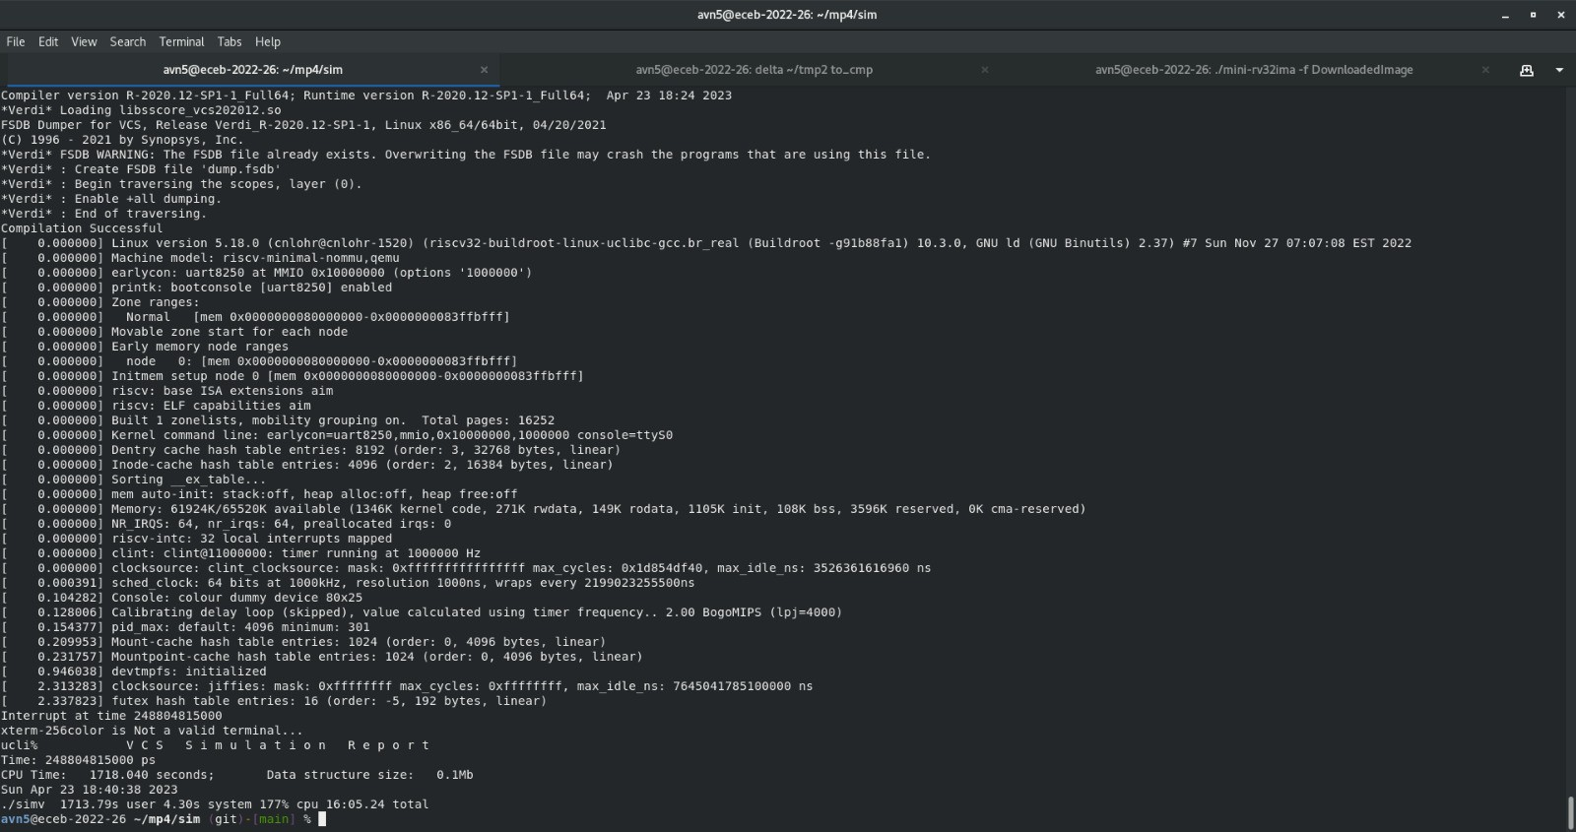
Booting nommu Linux…to some point.
. . . . . . . . . . . . . . . . . . . .
. . . . . . . . . . . . . . . . . . . .

Slide 15
Q/A
. . . . . . . . . . . . . . . . . . . .
. . . . . . . . . . . . . . . . . . . .

